Slide 1
Command-Line Arguments
Kaustubh Kulkarni

Slide 2
A Java application can accept any number of arguments from the command line.
Command-line arguments allow the user to affect the operation of an application for one invocation.
For example, an application might allow the user to specify verbose mode--that is, specify that the application display a lot of trace information.
This is done using the command-line argument -verbose.

Slide 3
The user enters command-line arguments when invoking the application and specifies them after the name of the class to run.
For example, suppose you have a Java application, called Sort, that sorts lines in a file.
To sort the data in a file named friends.txt, you would run it like this: java Sort friends.txt

Slide 4
In the Java language, when you invoke an application, the runtime system passes the command-line arguments to the application's main method via an array of Strings.
Each String in the array contains one of the command-line arguments.
In the previous example, the command-line arguments passed to the Sort application is an array that contains a single String: "friends.txt".

Slide 5
Note to C and C++ Programmers: The command-line arguments passed to a Java application differ in number and in type than those passed to a C or C++ program.
When you invoke a Java application, the system passes only one parameter to it:
args: An array of strings that contains the arguments
You can derive the number of command-line arguments with the array's length attribute:
numberOfArgs = args.length;
In Java, you always know the name of the application because it's the name of the class in which the main method is defined.
So the Java runtime system does not pass the class name you invoke to the main method.
Rather, it passes only the items on the command line that appear after the class name.

Slide 6
Parsing Numeric Command-Line Arguments
If your program needs to support a numeric command-line argument, it must convert a String argument that represents a number, such as "34", to a number.
Here's a code snippet that converts a command-line argument to an int:
int firstArg;
if (args.length > 0)
firstArg = Integer.parseInt(args[0]);
parseInt throws a NumberFormatException if the format of args[0] isn't valid.
All of the Number classes--Integer, Float, Double, and so on--have parse methods that convert a String representing a number to an object of their type.

Slide 7
Refer EchoArguments.java

Slide 8
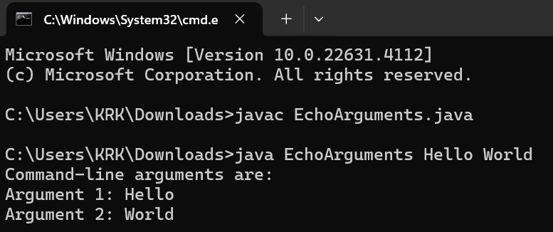

Slide 9
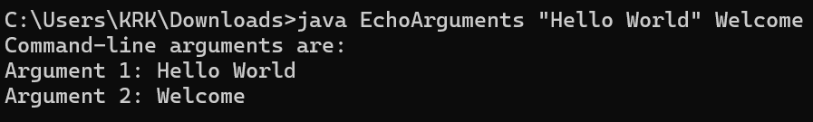

Slide 10
Refer SumOfNumbers.java

Slide 11
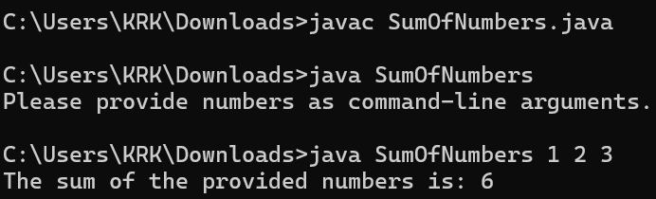

Slide 12


